Slide 1
NUTRITION

Slide 2
What’s your nutrition knowledge?

Slide 3
Why are we learning about healthy eating in school?
67 out of every 100 adults in the United States are overweight or obese

Slide 4
Knowing how to eat “right” will help you remain strong and healthy for the rest of your life.

Slide 5
Digestion
The process of breaking down carbohydrates into small sugar molecules (glucose)

Slide 6
Where does your body get its energy?
From food that we eat every day

Slide 7
What does the word “Nutrition” mean to you?

Slide 8
What is a nutrient?
Any material that can be taken into your body cells and is useful to your body
What is nutrition?
The study of nutrients and the effect they have on health
Does everyone have the same nutritional needs?
No! It depends on your age, body size, and level of activity

Slide 9
What does the word “essential” mean?
Something that is very important and necessary

Slide 10
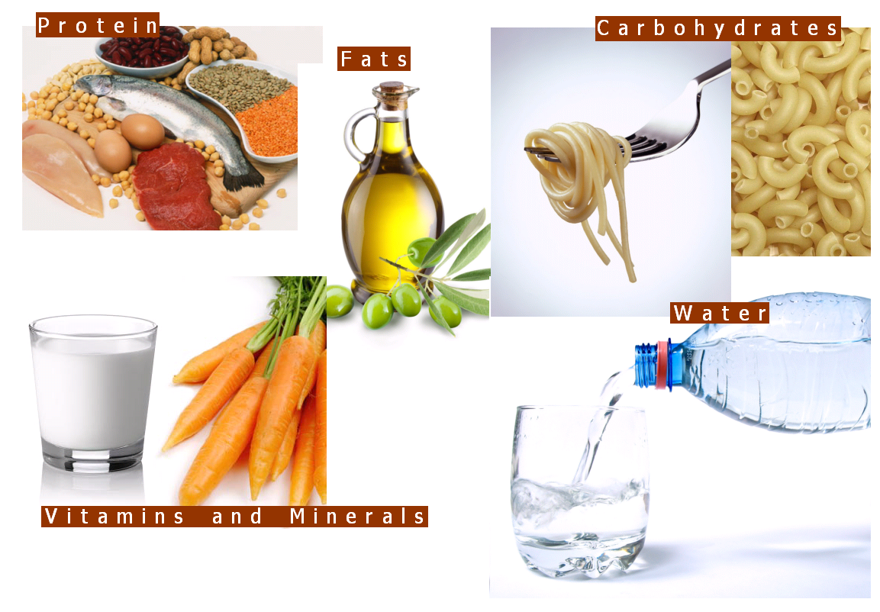
6 Essential Nutrients:
carbohydrates
fats
proteins
minerals
vitamins
water

Slide 11
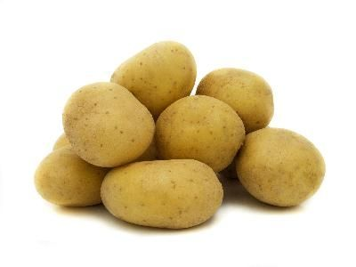
Carbohydrates
The major source of energy for your body
Two groups:
simple – sugars – easily digested
Complex –large sugar molecules, starches, and glycogen – take longer to digest

Slide 12
Fats
Store energy for future use
Keep the body warm
Protect the body
Two types:
Saturated – animal fats
Unsaturated – plant based
Saturated fats increase blood cholesterol – heart disease

Slide 13
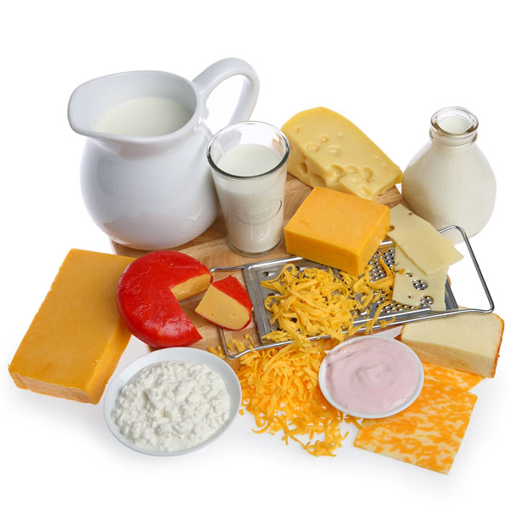
Protein
Responsible for growth and repair of body cells
Made up of amino acids
Humans need 20 amino acids
10 essential
10 non essential

Slide 14
Vitamins
Help your body perform certain functions
Help provide the nutrients that your cells, tissues and organs need.
Some stored, some not

Slide 15
Vitamins
Vitamin A – night vision – carrots
B vitamins – help get energy from foods
Vitamin C – helps absorb iron
Vitamin D – helps with calcium absorption
Vitamin E – anti-oxidant
Vitamin K – blood clotting

Slide 16
Minerals
More elements that the body needs to function properly
Most important is calcium
Growth and repair of bones and teeth

Slide 17
Minerals
Iron – helps blood carry oxygen
Manganese -helps the body form connective tissue, necessary for normal brain and nerve function.
Zinc - heal wounds and plays an important role in the immune system
Phosphorous – works with calcium
Magnesium – needed by every organ
Copper – helps make red blood cells

Slide 18
Water
The most important nutrient
Essential for ALL cells
5 functions:
takes nutrients to cells
carries waste products away from cells
cools the body – sweat
lubricates joints
saliva

Slide 19
Fiber
Not a nutrient, but still important
Complex carbohydrate
Fruits and vegetables
Wholegrain cereals
Helps the body move waste more easily

