Slide 1
REVIEW
What are the 6 essential nutrients?
Which nutrient gives you energy?
Which nutrient is responsible for repairing body cells?
Which nutrient is the most important one?

Slide 2
Introducing…MyPlate
MyPlate is a nutritional guide that helps us to make healthy eating choices.
MyPlate separates foods into different groups.

Slide 3
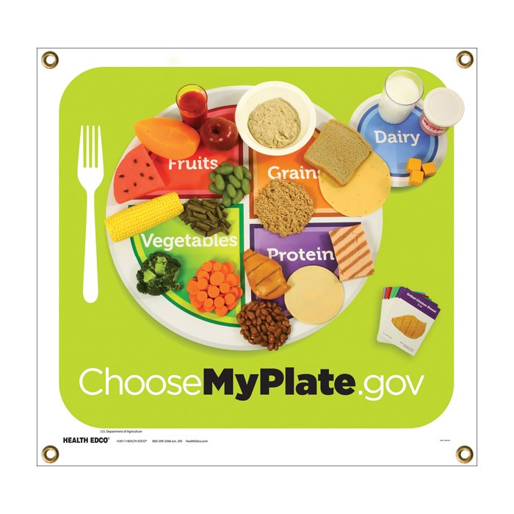
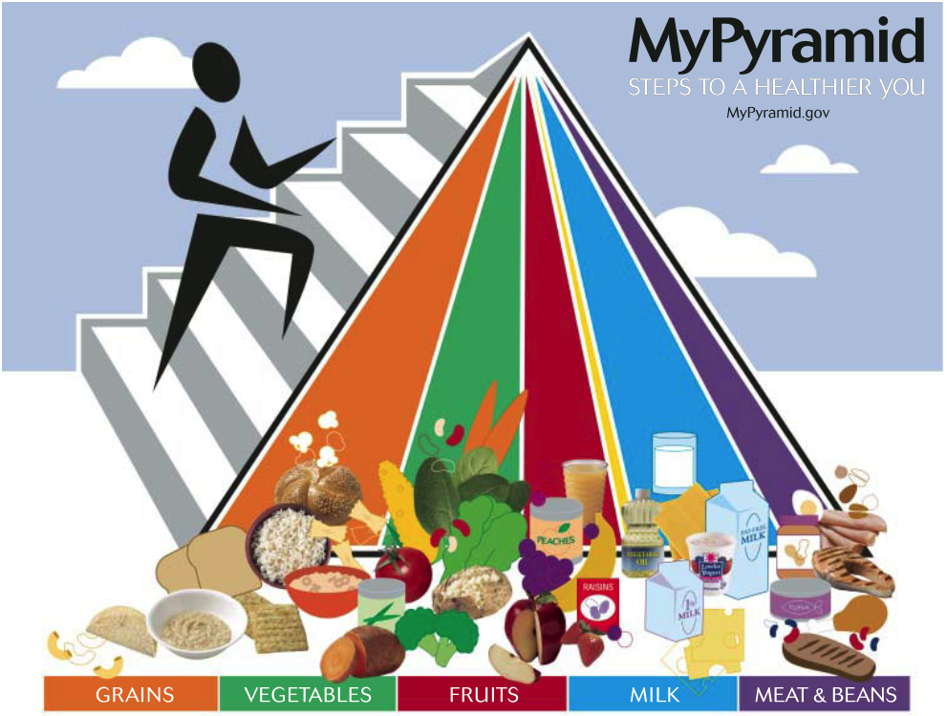

Slide 4
Grains
Grains are made up of carbohydrates.
Carbohydrates give the cells in your body the fuel they need!
There are two types of grains–
Whole grains and refined grains.

Slide 5
Whole & Refined Grains

Slide 6
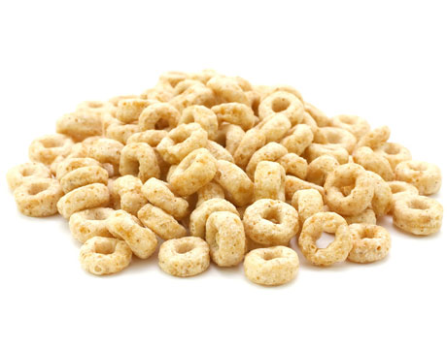
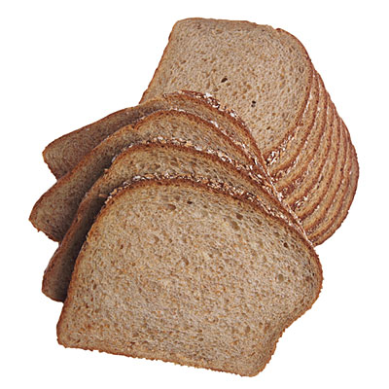
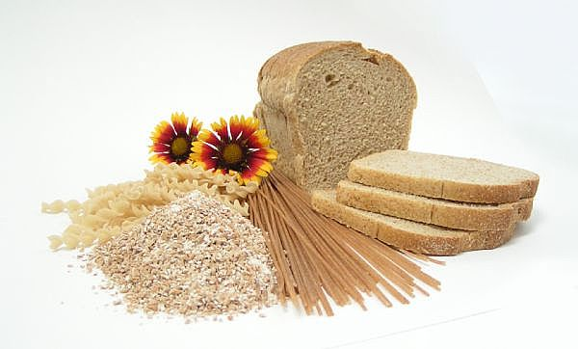
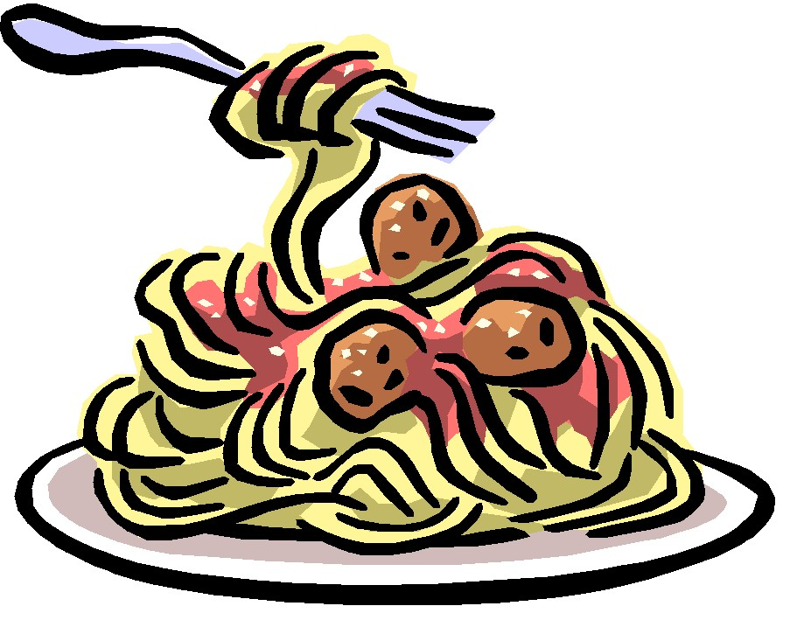

Slide 7
Vegetables
Vegetables are rich in nutrients but low in calories.
They help strengthen your immunes system!

Slide 9
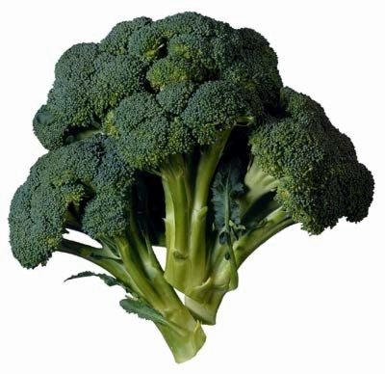
Tips: Eat more dark green
and orange vegetables

