Slide 1
REVIEW
Which food groups should make up half your plate?
Which food group is made up simple and complex carbohydrates?
Which food group/s are the most colorful and make your plate look like a rainbow?

Slide 2
What is a serving size?

Slide 3
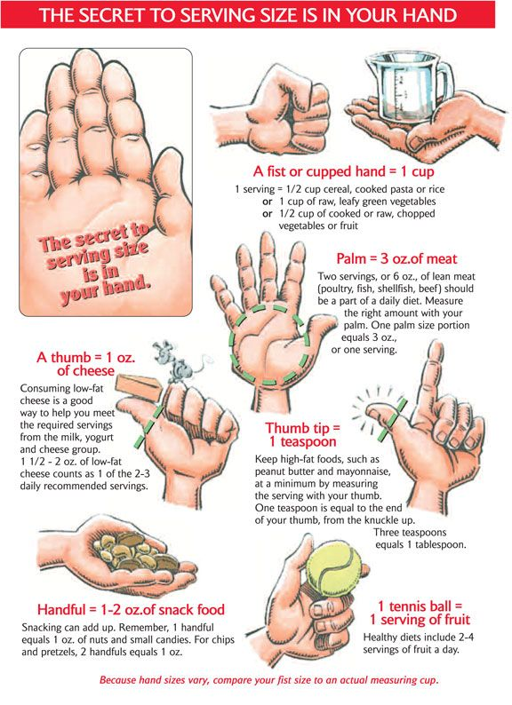

Slide 4
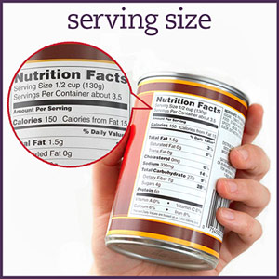
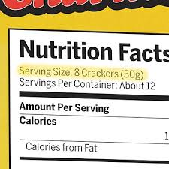
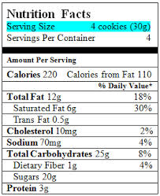
Where can I find out a food’s serving size?

Slide 5
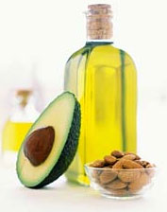
Oils
Olive oil and cooking oil
These oils are good for
you, and your body needs
them to survive!
Healthy fats help protect
your organs and keep them
in place!

Slide 6
What kinds of food do you not see on the My Plate?

Slide 7
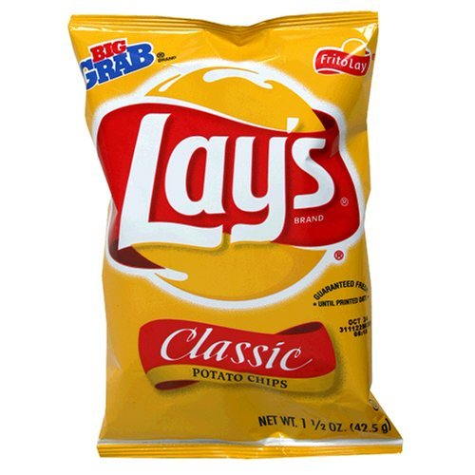
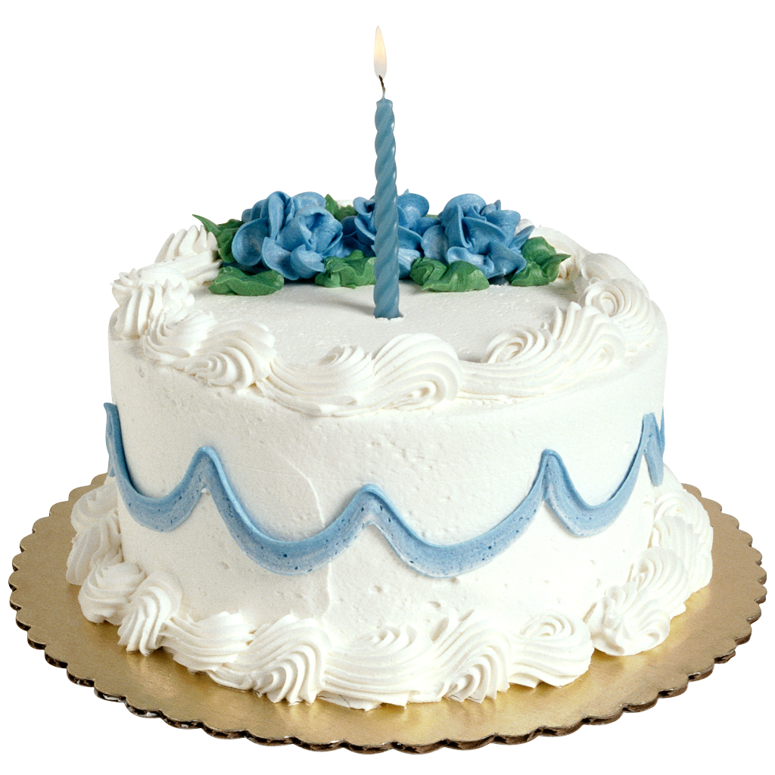
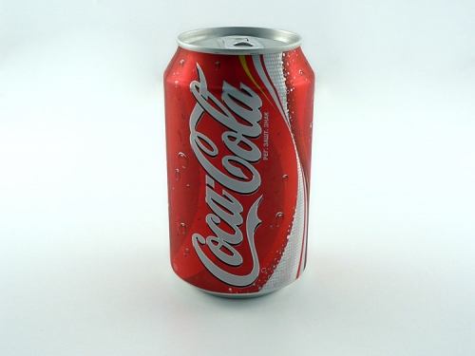
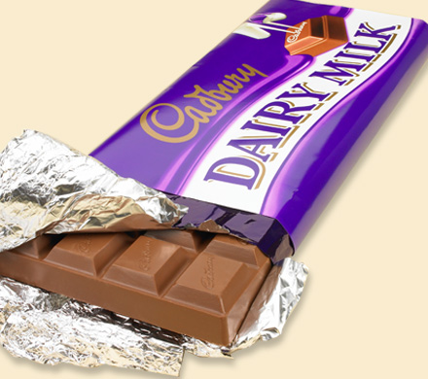
Empty Calories
Have no nutritional value
Soda, potato chips, cookies, sweets, candy

Slide 8
Directions
As I post a photo, tell me what area on the food pyramid it belongs on!

Slide 9
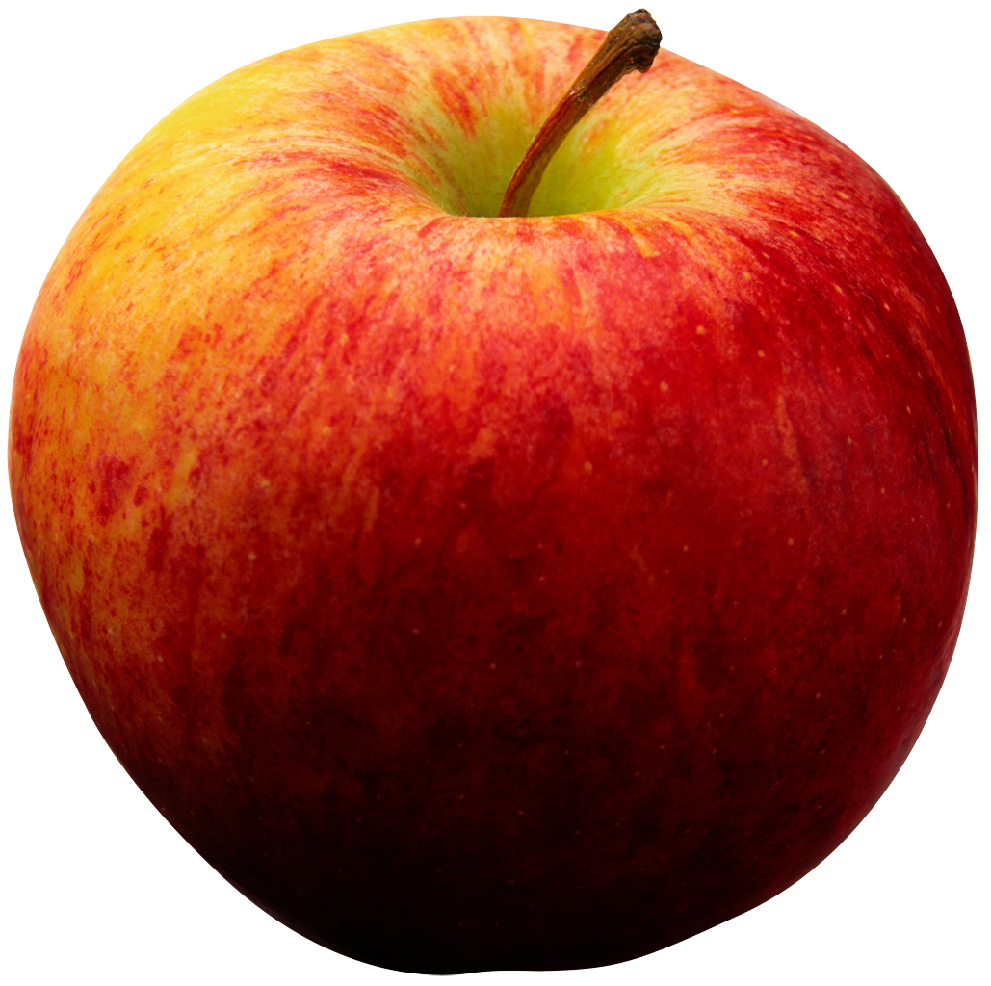

Slide 10
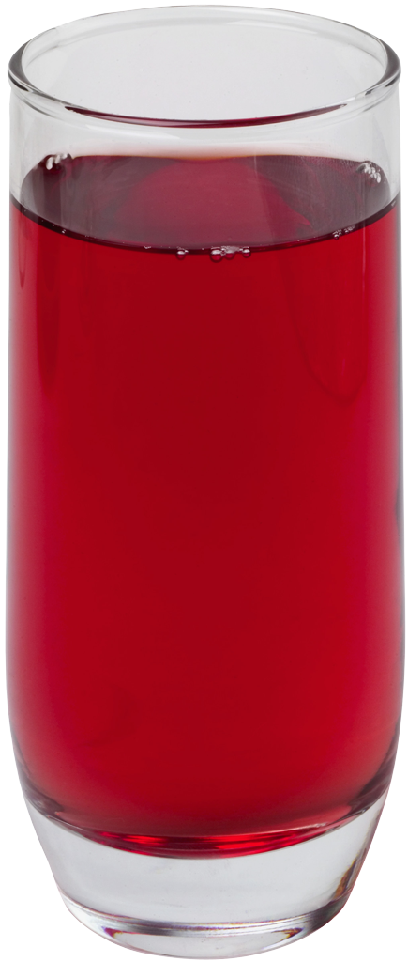

Slide 11
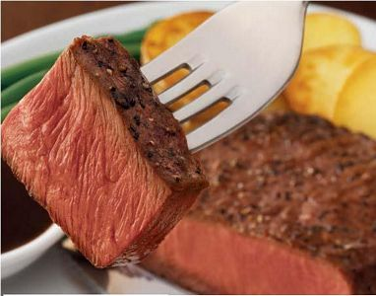

Slide 12
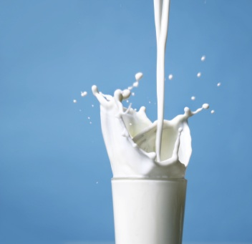

Slide 13
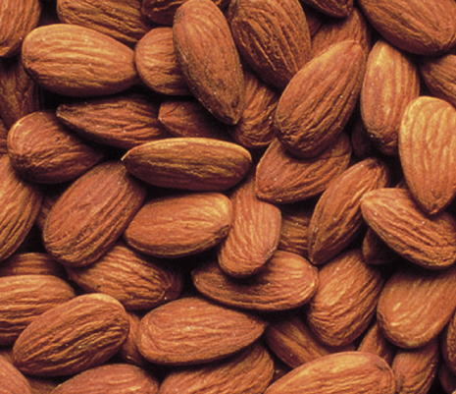

Slide 14
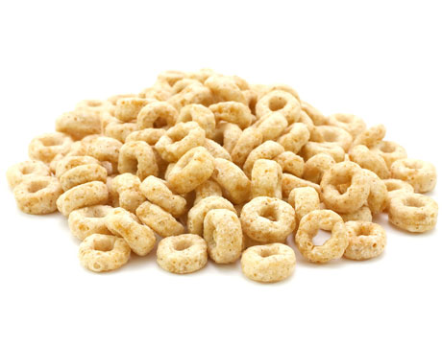

Slide 15
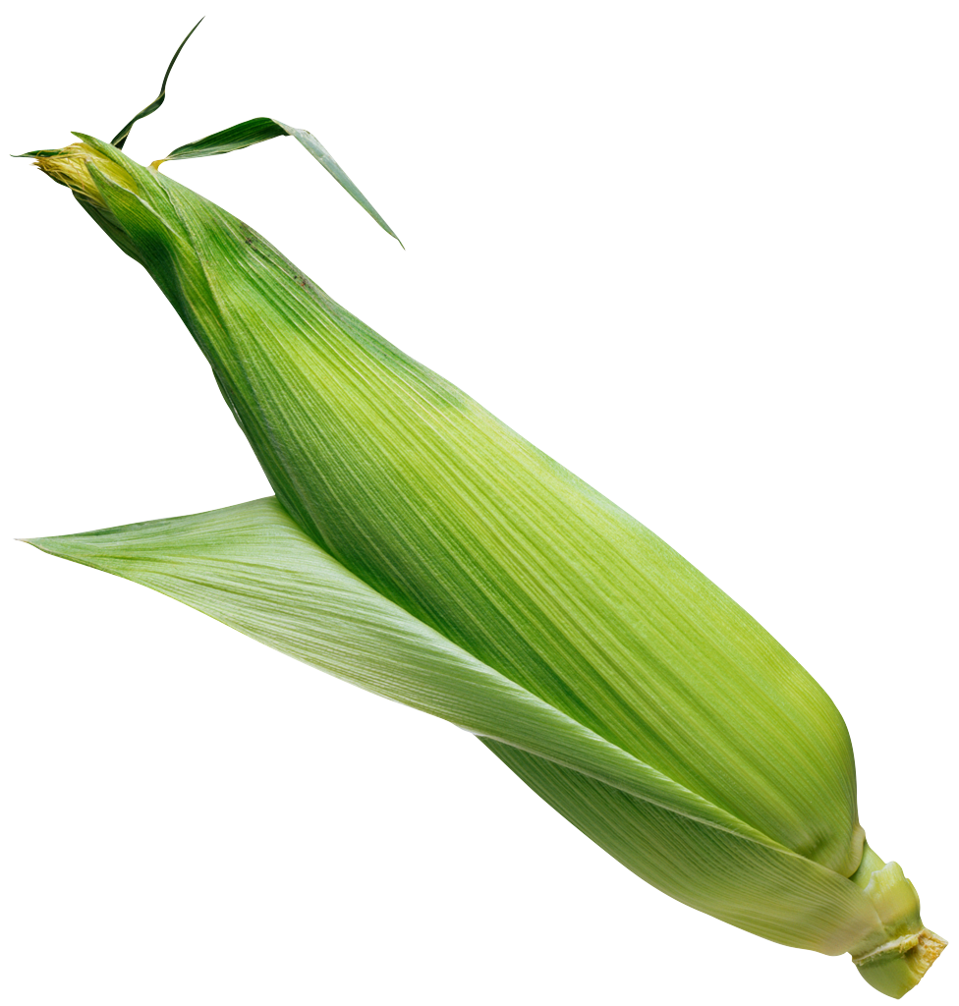

Slide 16
Serving Size Quiz
What does a serving size look like?

Slide 17
QUIZ: What Makes a Serving?
• A huge bag of Ruffles is helping you get through your science homework. You polish off about ½ a bag or 50 chips. How many servings of chips have you just eaten?
1
2 1/2
5

Slide 18
The Answer: C
An official serving of Ruffles is one ounce, which is about 10 chips. Half a bag is 5 servings.

Slide 19
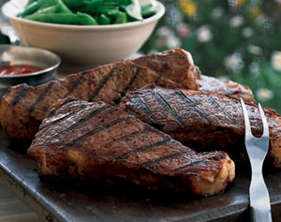
QUIZ: What Makes a Serving?
One serving of steak is about as big as:
A deck of cards
A CD with case
C. A paperback book

Slide 20
The Answer: A
An official serving of steak is three ounces or about as big as a deck of cards. A typical slab you would get at a steak house would be five times that size.

Slide 21
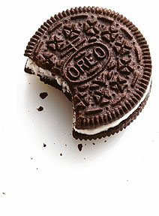
QUIZ: What Makes a Serving?
According to the label on a package of Oreos, one serving has 100 calories and five grams of fat. How many cookies are
in a serving?
1
2
3

Slide 22
The Answer: B
An official serving of Oreos is 2 cookies. But who can stop at just 2?

Slide 23
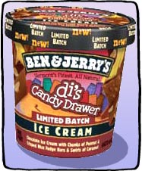
QUIZ: What Makes a Serving?
The label on your favorite brand of ultrasinful ice cream says that one serving has a killer 300 calories and 15 grams of fat. How many scoops are in one serving?
3
2
1

Slide 24
Answer: C
One official serving is one scoop, just ½ a cup.

Slide 25
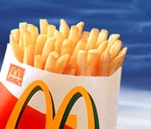
QUIZ: What Makes a Serving?
On “official” serving of french fries contains 3 ounces. How many servings are in a McDonald’s Super Size french fries?
1
2
3

Slide 26
Answer: C
A Super Size french fries contains three official servings, adding up to 540 calories.

Slide 27
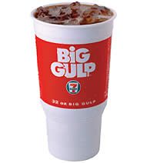
QUIZ: What Makes a Serving?
A 7-Eleven Double Gulp contains how many servings of soda?
2
4
8

Slide 28
Answer: C
A Double Gulp has eight servings, more than enough to quench the thirst of a large family. A can of soda contains 1 ½ servings.

