Slide 1
REVIEW
A fist is equal to what? (serving size)
Why should we worry about serving size?
Where can you find the serving size of food?

Slide 2
24 Hour Diet Recall
Think about what you ate yesterday
If you don’t remember then think about what you ate so far today.
Fill in the chart
Mark which food group the foods you ate fall under
Some may fall under more than one
For example: a turkey sandwich with lettuce and tomato would fall under grains, protein, and vegetable

Slide 3
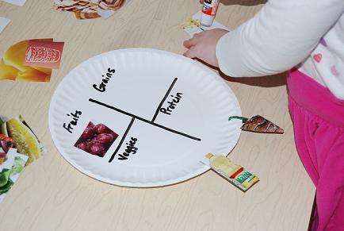
Make your Own MyPlate Activity

Slide 4
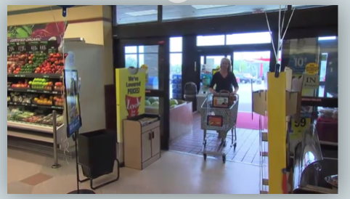
Watch a video on "Grocery Store Savvy”
http://www.youtube.com/watch?v=-R7cCIg8iDQ

